Slide 1
EN 50366:2003
Household and similar electrical appliances-
Electromagnetic fields-
Methods for evaluation and measurement

Slide 2
Content
Introduction
Scope & Definition
Measuring Methods
Test report
Compliance criteria
Annex
Example

Slide 3
Introduction
What do we measure:
B=k(I/r)
B=c/(r+r0)
How do we measure:
Ø=B*S

Slide 4
Scope and Definition
Evaluating the electric field and magnetic field;
Around household and similar electrical appliance;
Motheds apply to the general public;
Basic restriction, reference level, measuring distance,
operator distance; hot spot and coupling factor.

Slide 5
Measuring methods
4.1 Electric fields
4.2 Magnetic field
        4.2.1 Fequency Arrangement;
        4.2.2 Measuring distance, sensor locations and operating conditions;
        4.2.3 Magnetic field sensor;
        4.2.4 Measuring procedures for magnetic fields

Slide 6
Measuring methods
4.2.4 Measuring procedures for magnetic fields
    Three procedures;
    Transient magnetic fields is not include;
    The background level <5%;
    The reponse time<2s;
    Averaging time 1s;

Slide 7
Measuring procedures for magnetic fields
Three procedure :
    Time domain evaluation
    Line spectrum evaluation
    Simplified test methods

Slide 8
Measuring methods
Measurement uncertainty:
      The total error <25%;
      Uncertainty implement:
        By manufacture
        Test result+uncertainty< limit
        By authorities for market surveillance
        Test result-uncertainty<limit

Slide 9
Test Report
Identification;
Rated appliance;
The measuring method;
Measuring distance, sensor locations and operating conditions;
The maximum magetic flux density.

Slide 10
Compliance Criteria
If the result < reference limit, appliance comply with basic limit;
If the result > reference limit, the coupling factor is used;
If the result is still over reference limit, the calculation methods are under consideration.

Slide 11
Annex
Test condition
Basic restrictions and reference levels;
Determination of coupling factors;
Representation of human body and magnetic field;

Slide 12
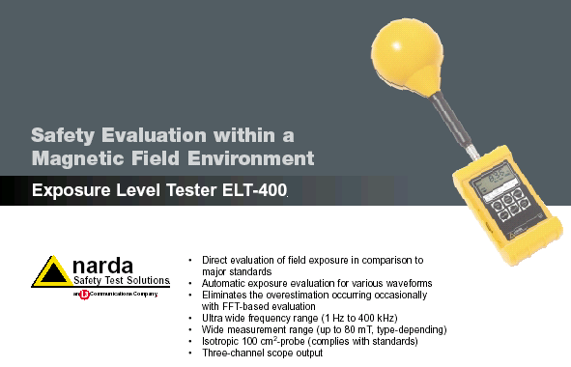
Example

Slide 13
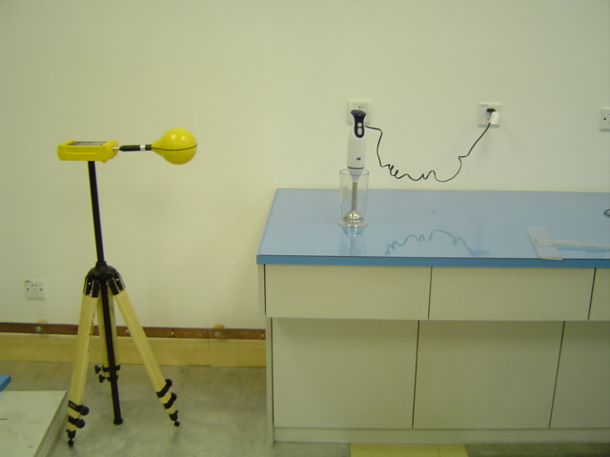
Example

Slide 14
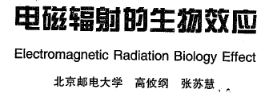
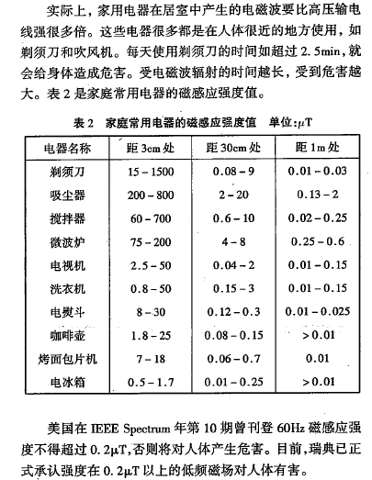
Example

Slide 15
FAQ and Q&A
Q:In case of series product, How to choose sample?
A:
Q:Price and lead time?
A:7,500RMB and 3 Weeks
Q:What package we can provide to client?
A: AK certificate and test report.

